Slide 1

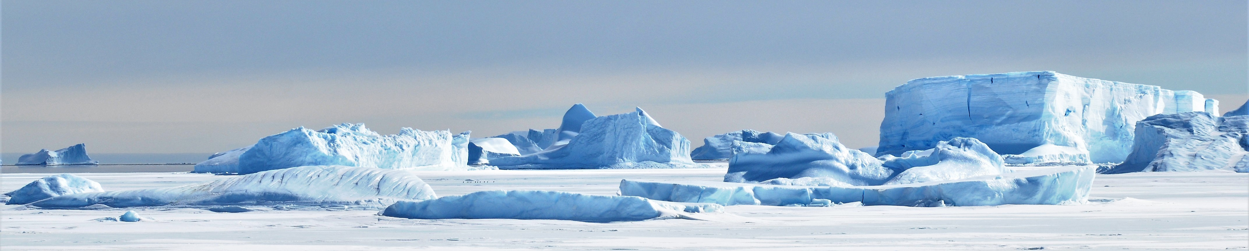
Antarctic environmental protection
International governance through the Antarctic Treaty system
Dr Phil Tracey, Australian Antarctic Division

Slide 2
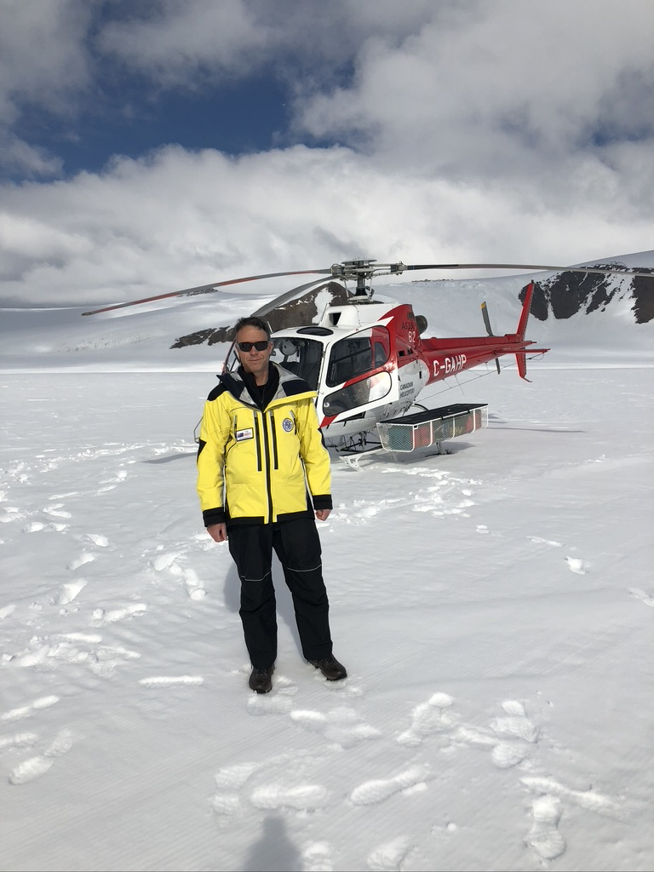
Background
Not a lawyer or educator
A practitioners perspective – international law making, policy development and negotiation, and domestic law in the unique environmental, legal political context of Antarctica
Postgraduate research
Environmental policy, EIA and audits
Project management
Tourism policy
Inspections
Representation at ATCM and CEP
Co-chair of ATCM working group

Slide 3
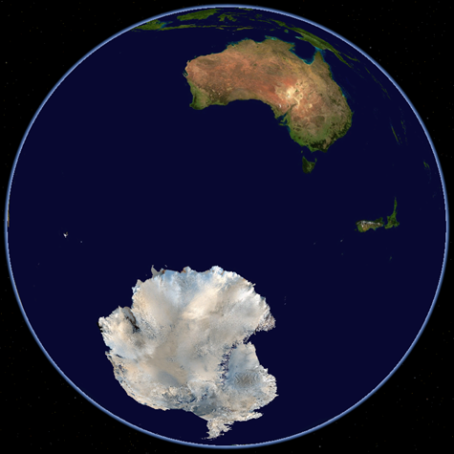
Antarctica as a case study
Politically, legally, socially and environmentally unique
A key example of successful international cooperation
Relevant to the Global environmental protection syllabus:
  A bespoke international governance and management regime that ensures comprehensive environmental protection
  Intersection of state sovereignty, jurisdiction, and international cooperation
  An example of changing environmental norms and values reflected in international law
  Legal and non-legal tools and mechanisms
Relationship with UN bodies and other instruments
Institutions and mechanisms
Role of States
Deals with compliance, conflict and disagreement

Slide 4
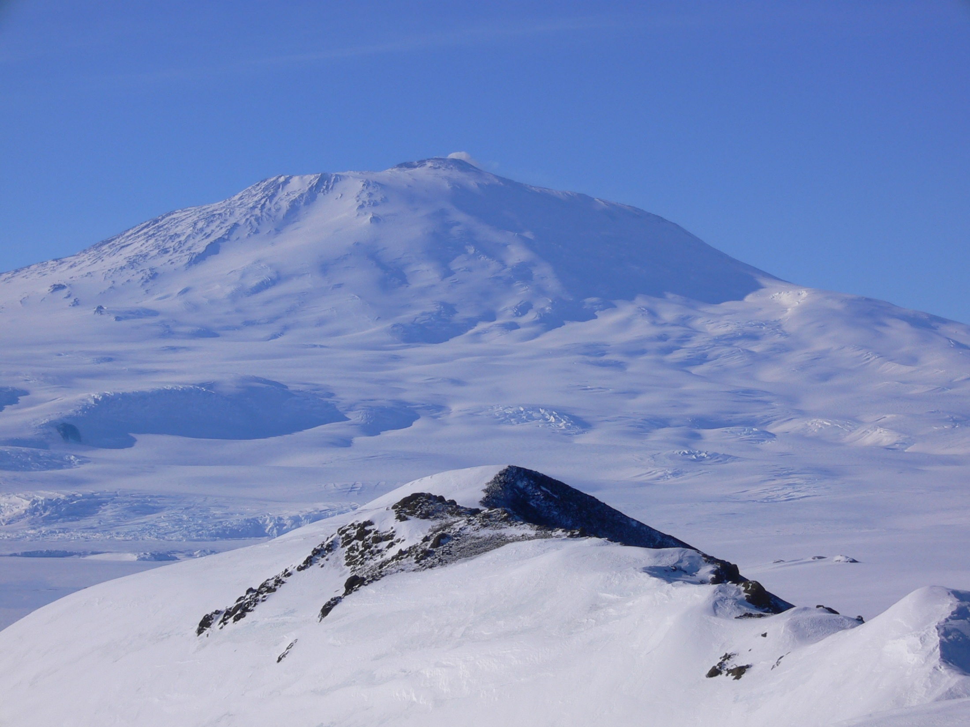
The Antarctic region
Highest, driest, coldest, windiest
98% ice covered
Ice free areas are very important
  Wildlife, vegetation and human activities are concentrated on ice free areas
Antarctica’s values
  Scientific
  Environmental (including dependent and associated ecosystems)
  Wilderness and aesthetic
  Historic
  Global climate services
  Economic uses

Slide 5
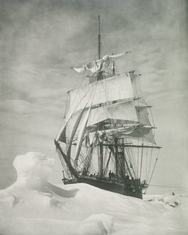
History
Discovery – Cook, Bellingshausen, Bransfield, Smith, Palmer
Sealing, whaling
Exploration and expeditions
Heroic era – 1899 to 1915
  Exploration and territorial claims
  Scott, Shackleton, Amundsen, Mawson
International Geophysical Year of 1957-1958
  Scientific bases
  Major post-war expeditions
  Cold war context

Slide 6
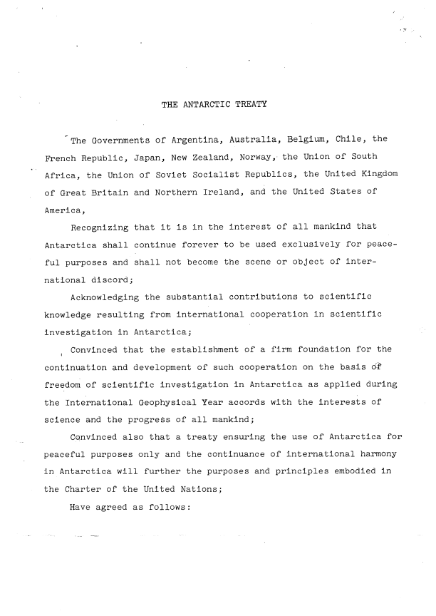
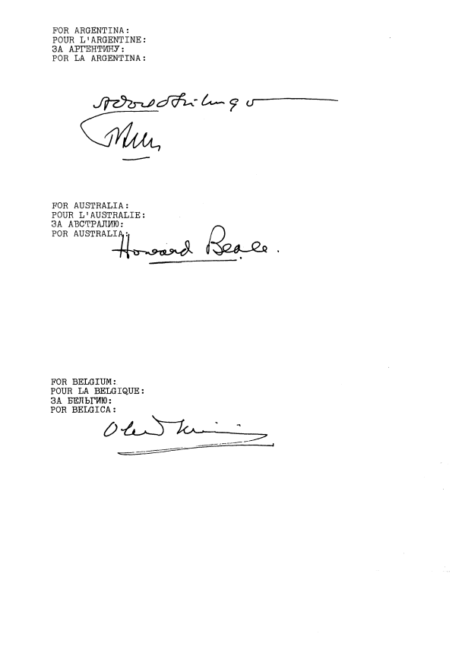
The Antarctic Treaty
Signed 1959 by the 12 countries active in the IGY
Open to all UN states
Applies south of 60 degrees south
Establishes Antarctica as a continent of peace and science
Scientific cooperation
Non-militarisation
No nuclear explosions or waste
‘Sets aside’ territorial claims
Freedom of access for scientific purposes
Inspections and information sharing
Maintains high seas rights
Dispute resolution
Review mechanism

Slide 7
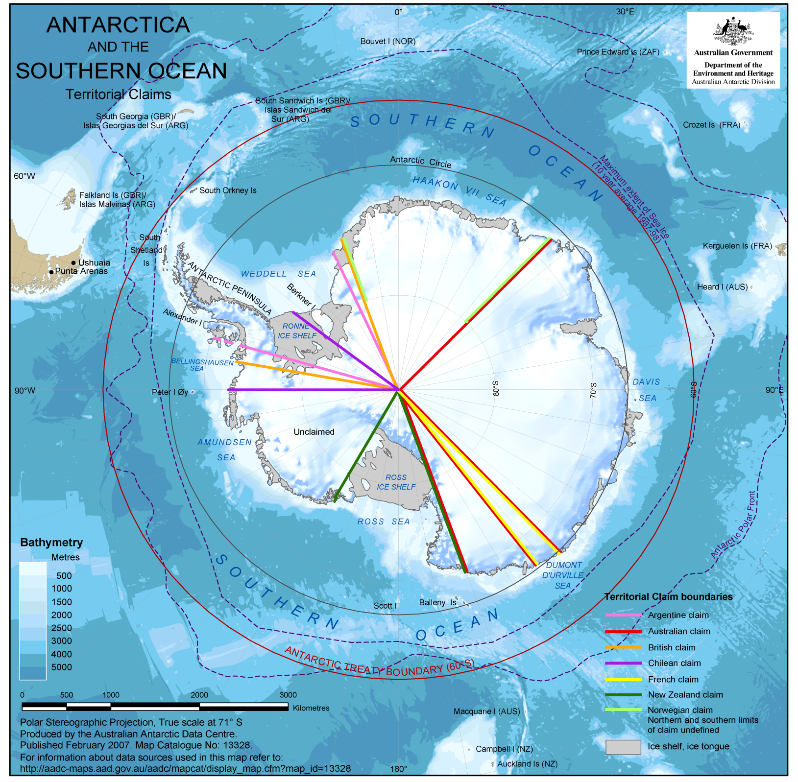
Sovereignty
Pre-1959
  Pre-existing claims to sovereignty deriving from discovery
  Overlapping claims
  Some mutual recognition
  States maintaining a basis for claims
  States not recognising Antarctic sovereignty
The Treaty effectively ‘sets aside’ issues of sovereignty while preserving all positions.
The Treaty explicitly cannot be interpreted as a renunciation of a claim to sovereignty, a basis of claim to sovereignty, or prejudicing the position of a Party regarding recognition or non-recognition.
No acts or activities taking place while the Treaty is in force create a basis for asserting, supporting or denying a claim, and no new claims or enlargements shall be asserted.

Slide 8
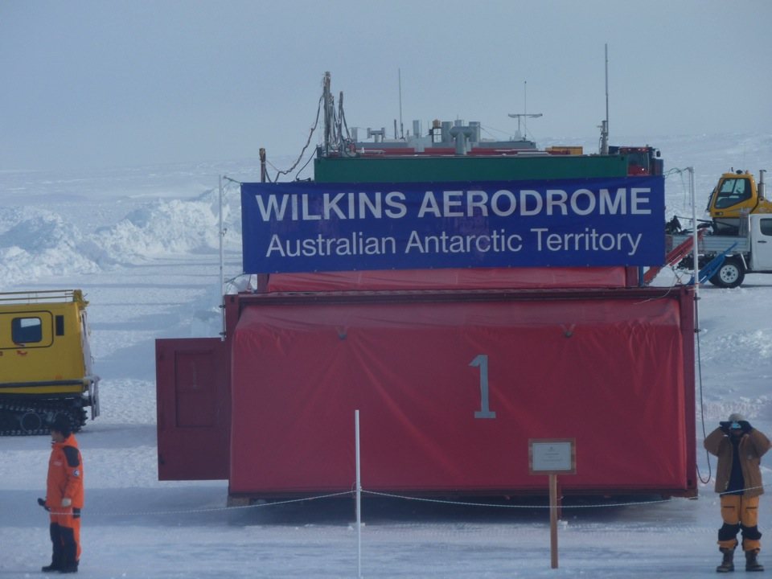
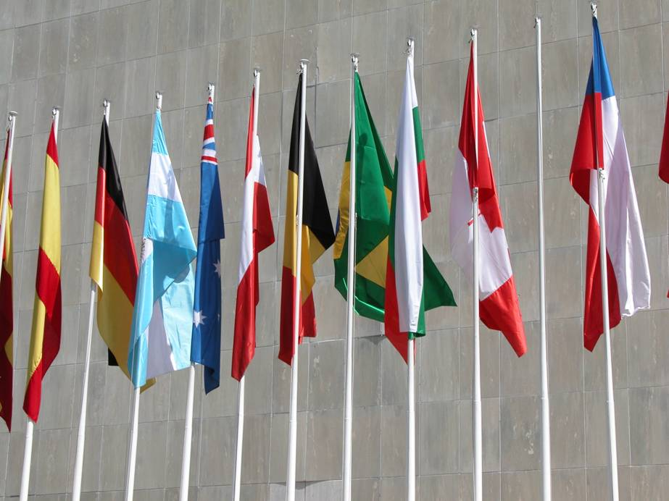
Jurisdiction under the Treaty
Claimant states act consistent with their position on sovereignty, including applying domestic laws to their claimed territory
Consistent Article IV, they do not seek to apply their domestic laws to others in their claimed territory
Parties exert jurisdiction over their nationals in Antarctica
A range of legal conundrums and jurisdictional challenges can be posited
But the legal ambiguity arising from the Treaty’s accommodation of views of sovereignty is a necessary and central element of the system
Internationally agreed rules for Antarctica, including environmental protection provisions are enacted by Parties domestically, usually in legislation

Slide 9
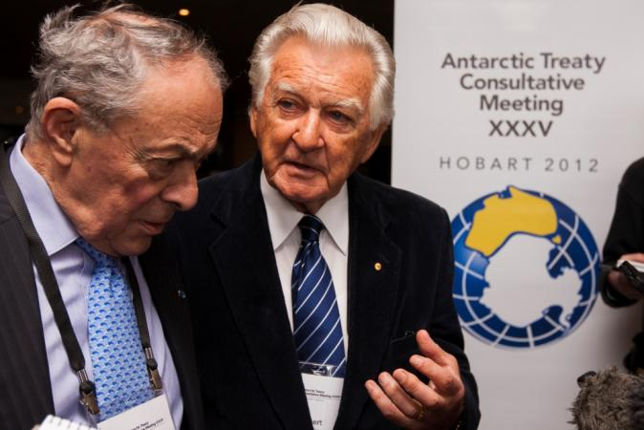
Environmental Protection
The Antarctic Treaty did not cover environmental protection
  Parties from an early stage took measures to conserve flora and fauna, historic sites and monuments, and scientific values and areas
In the 1980s the prospect of mining (and interest in exploration) prompted the negotiation of the Convention on the Regulation of Antarctic Mineral Resource Activities.
  environmental management elements
  clarity over rights and benefits
  Signed against a backdrop of growing environmental consciousness and pressure for an ‘Antarctic World Park
  Australian and French leaders decided not to ratify the Convention, meaning that it would not enter force
  And led development of a comprehensive environmental protection Protocol signed in 1991

Slide 10
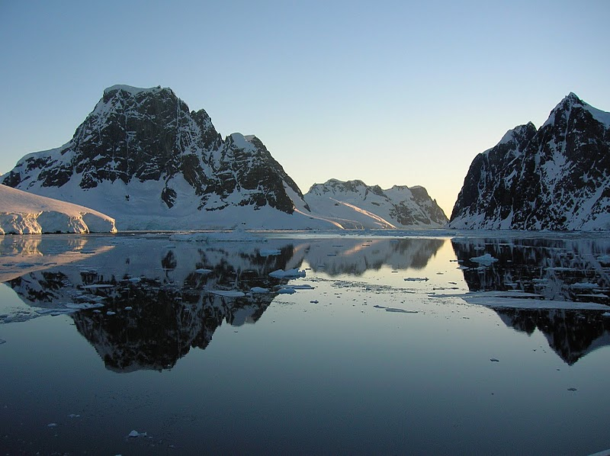
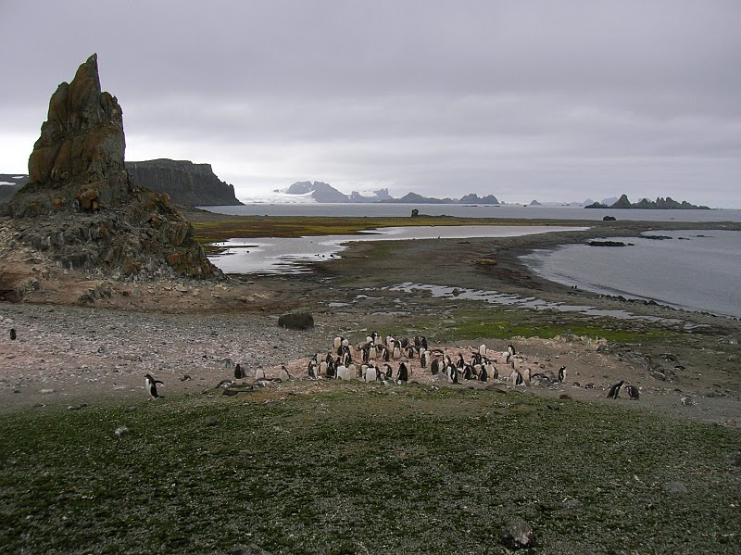
Protocol on Environmental Protection to the Antarctic Treaty
Establishes Antarctica as a natural reserve devoted to Peace and Science
Provides comprehensive environmental protection through key principles
Bans mining and mineral resource activity
Establishes a system of protected areas
Provides for special species protection
Requires environmental impact assessment of all activities
Regulates waste disposal and marine pollution
Assigns liability for environmental damage
Includes all 29 Treaty Consultative Parties and 13 non-Consultative Parties
All Parties active in Antarctica are Party to the Protocol

Slide 11
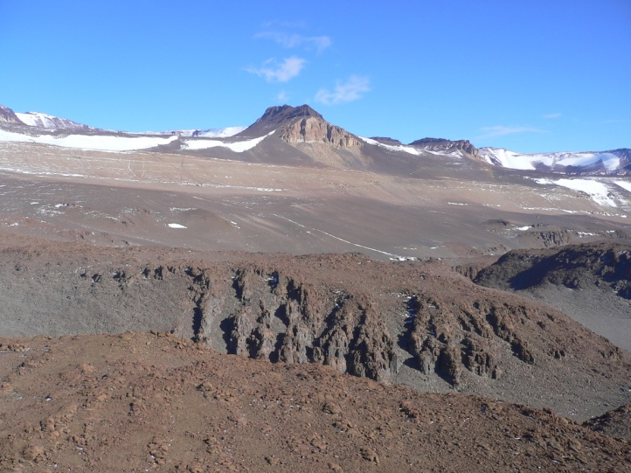
The mining ban – avoiding myths
Article 7: Prohibition of Mineral Resource Activities
  Not a moratorium
  The mining ban is indefinite
  The Protocol and its ban on mineral resource activities do not expire
  The Protocol contains review provisions, which mean that after 2048 a review conference could be called
  But any change to the mining ban is subject to strict decision rules, including those which effectively mean that Australia or other Parties could stop the lifting of the ban
Any activity relating to mineral resources other than scientific research, shall be prohibited.

Slide 12
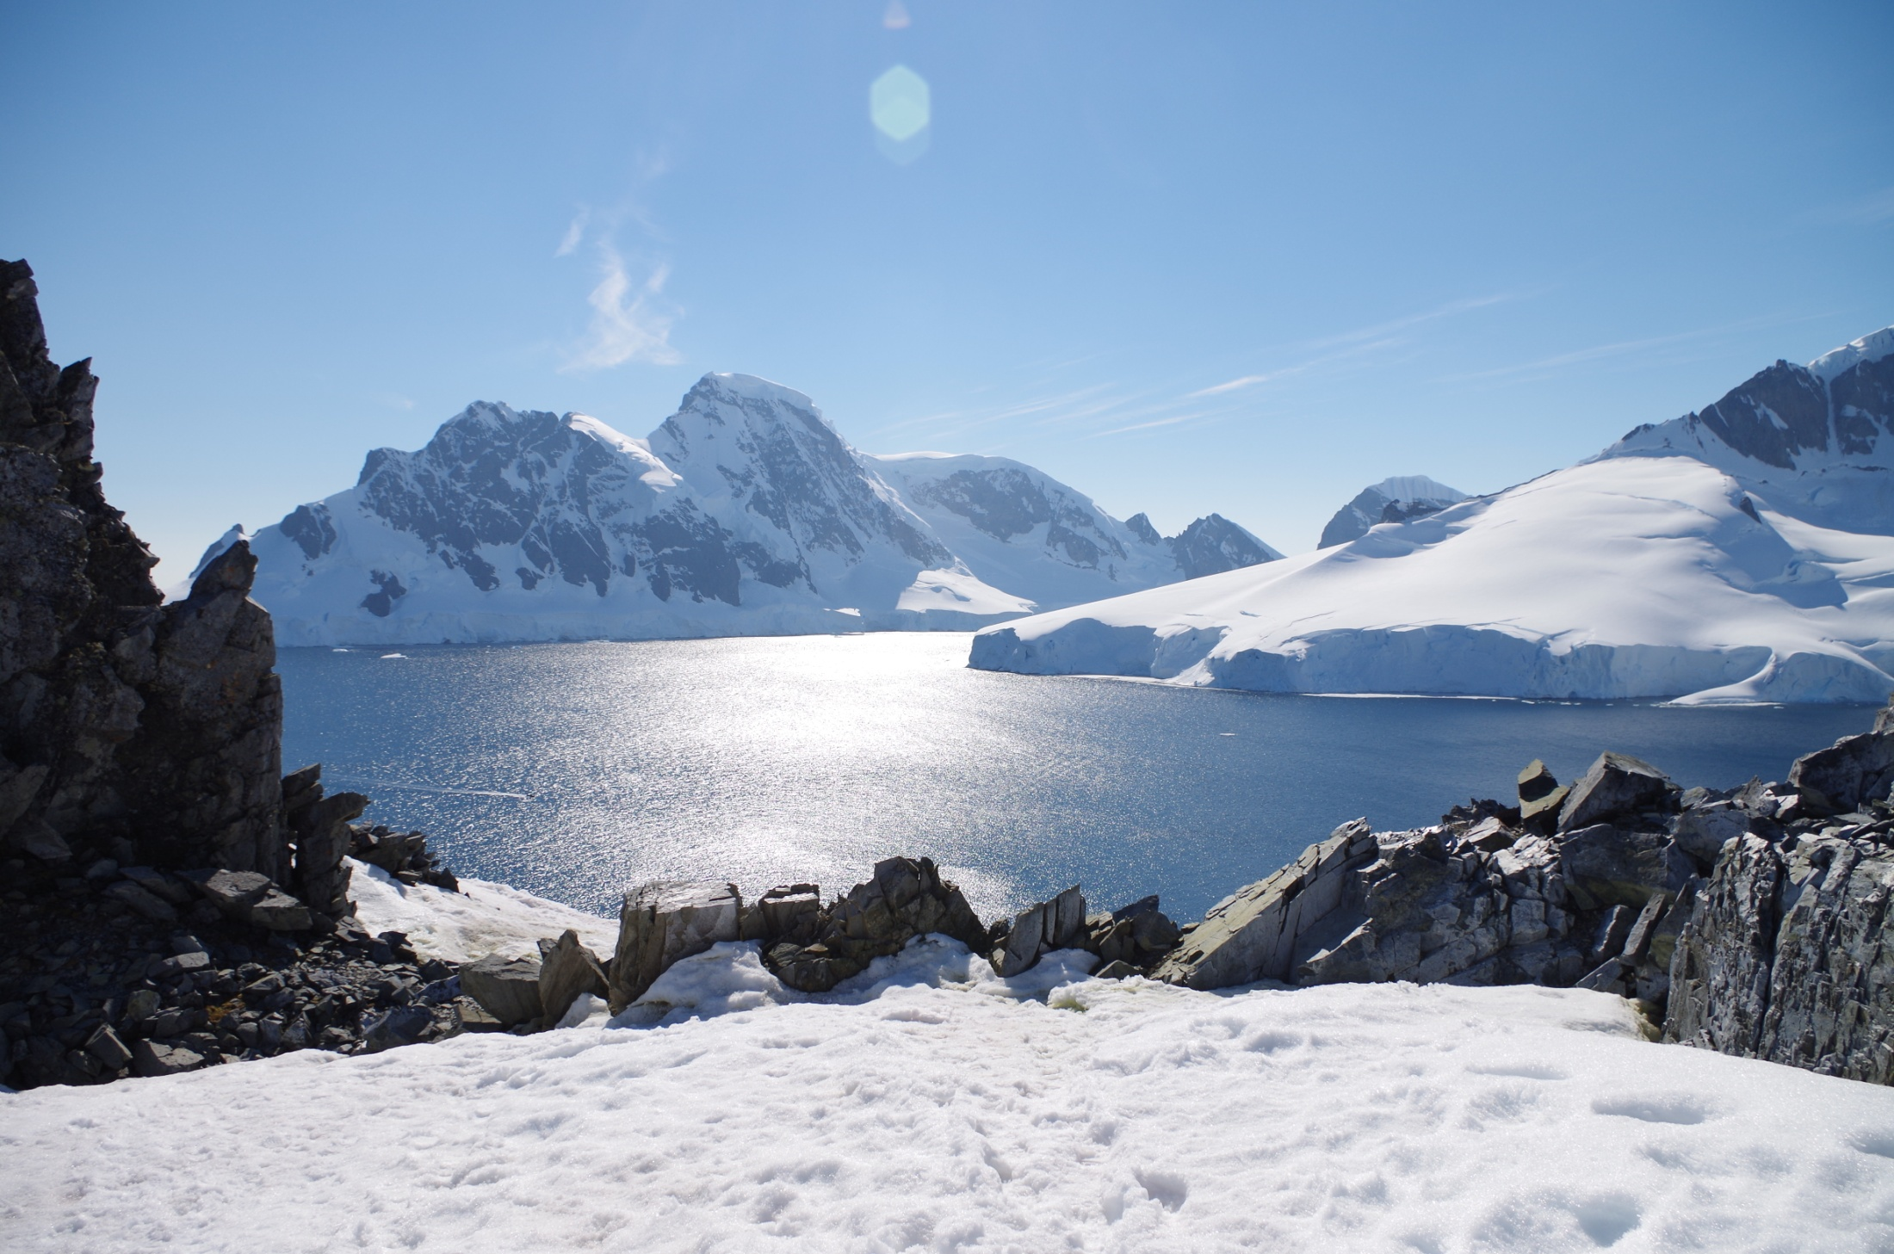
The Antarctic Treaty system
Centred on the Antarctic Treaty and its fundamental provisions
Supplementary Treaty-level international agreements
Convention on the Conservation of Antarctic Marine Living Resources (1980)
  Conservation including rational use
  Ecosystem approach to management, including consideration of dependent and associated ecosystems in managing fisheries
  Marine protection including MPAs
Protocol on Environmental Protection to the Antarctic Treaty (1991)
Convention for the Conservation of Antarctic Seals (1972)
Measures and decisions taken under these agreements
Collectively - the competent international governance and management regime for the Antarctic region

Slide 13
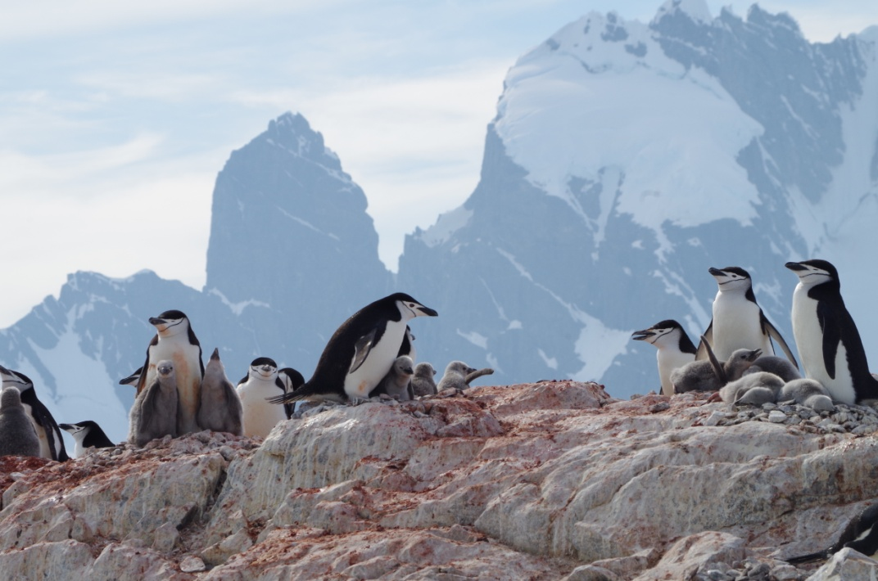
The Antarctic Treaty system
Long standing and successful international cooperation
Successful in ensuring peace and other key objectives
Open to accession by any UN Member, and now with 53 Parties to the Treaty including all Parties active in the region.
Adaptable and evolving (climate change, activities and technology)
Coexists with other international agreements, but some do not apply in the region

Slide 14
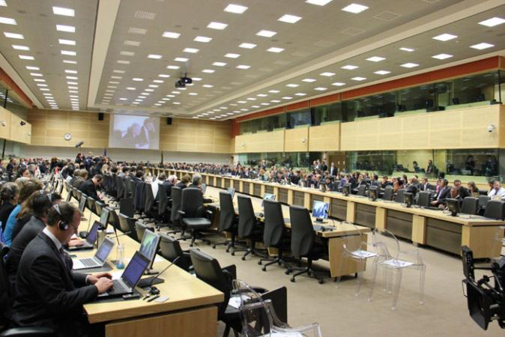
Meetings and negotiations
Antarctic Treaty Consultative Meeting
Committee for Environmental Protection
CCAMLR Commission
Civil society, observers and expert organisations
Government delegations – State engagement
Consensus decision making
Taking of measures (legally binding), decisions and resolutions
Mulitlateral meetings, official languages
Secretariat support
Proposals, policy making, and decisions
Reflection in domestic law
Special meetings and negotiations
Transparency and public outreach

Slide 15
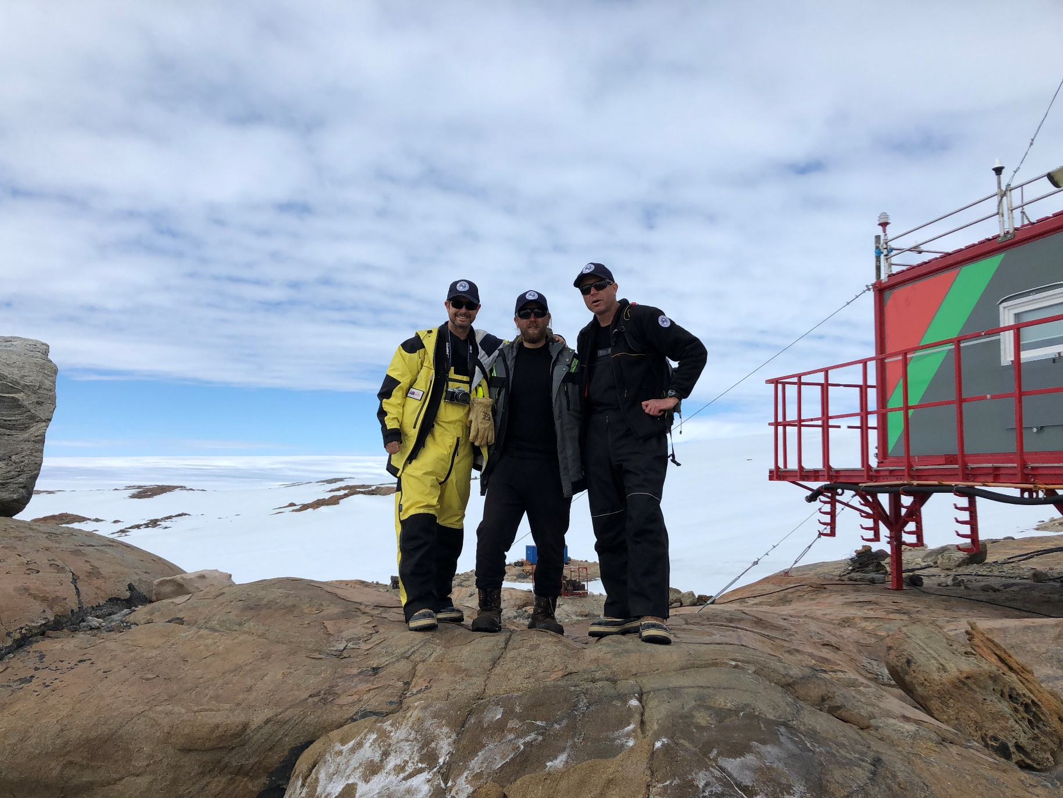
Verification – inspections and information
The Treaty, Protocol and CCAMLR include inspection provisions
Can consider all matters under the Treaty (eg. peaceful use) and Protocol (environmental compliance)
Ensure compliance, openness and transparency
Observers can be appointed to carry out inspections of any stations or facilities without notice
Actively used, including Australian inspection activity
No adverse findings on key provisions
Promote good practice, awareness and information sharing
Drawing attention to environmental issues and challenges

Slide 16
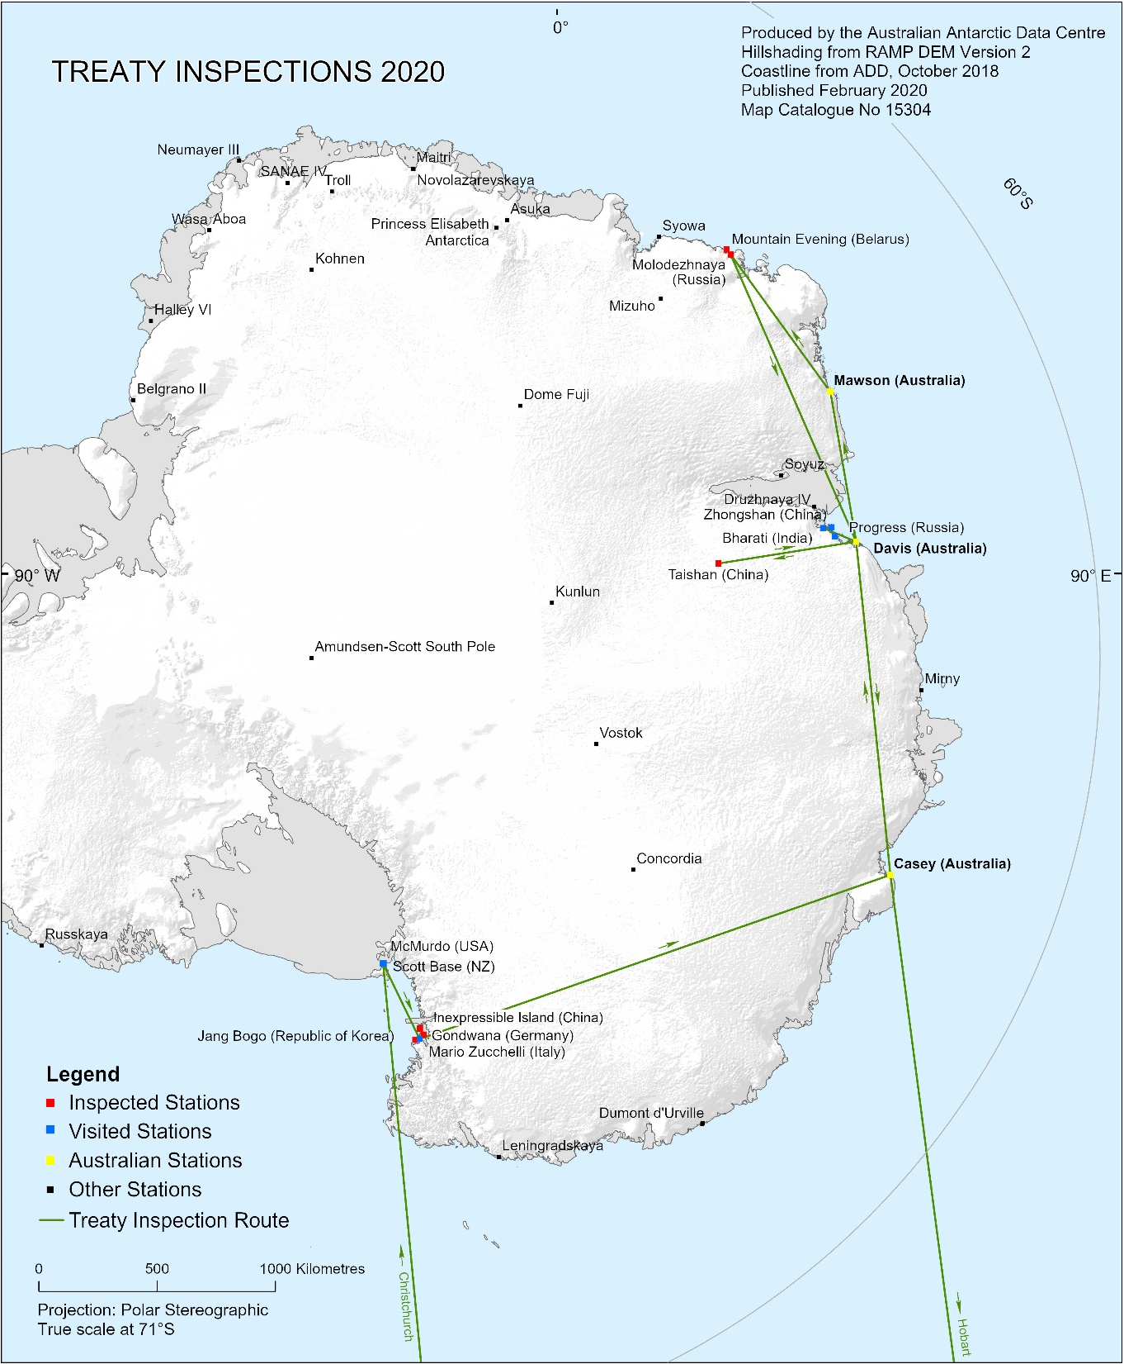
Australian inspections 2020
Jang Bogo Station (Republic of Korea)
Inexpressible Island facility (People’s Republic of China)
Gondwana Station (Germany)
Taishan Camp (People’s Republic of China)
Molodezhnaya Station (Russian Federation)
Mount Vechernyaya - Mountain Evening (Republic of Belarus)

Slide 17
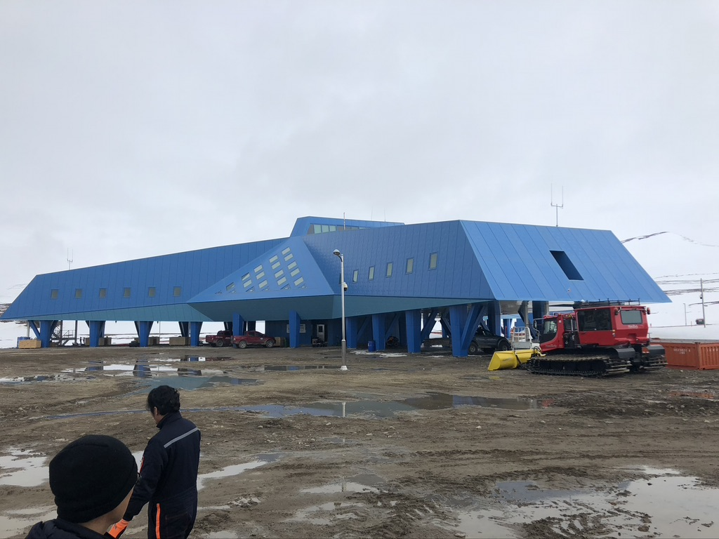
Australian inspections 2020
Jang Bogo Station (Republic of Korea)

Slide 18
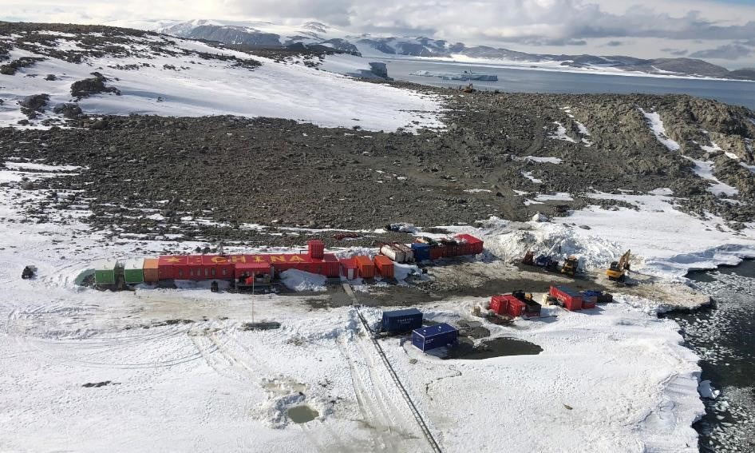
Australian inspections 2020
Inexpressible Island facility (People’s Republic of China)

Slide 19
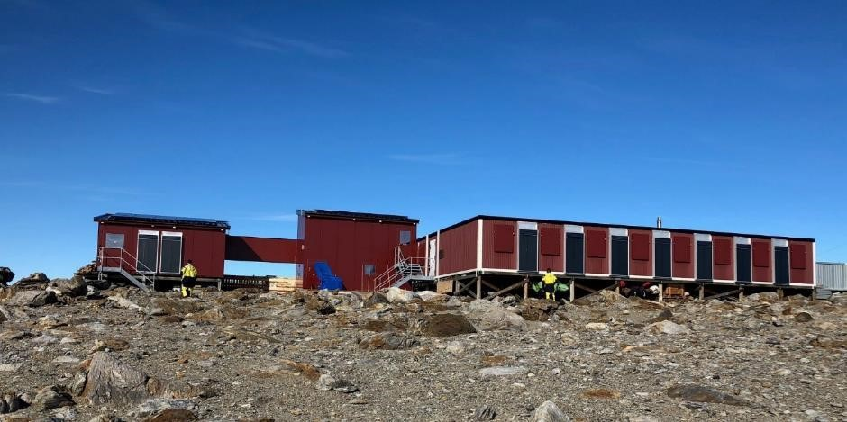
Australian inspections 2020
Gondwana Station (Germany)

Slide 20
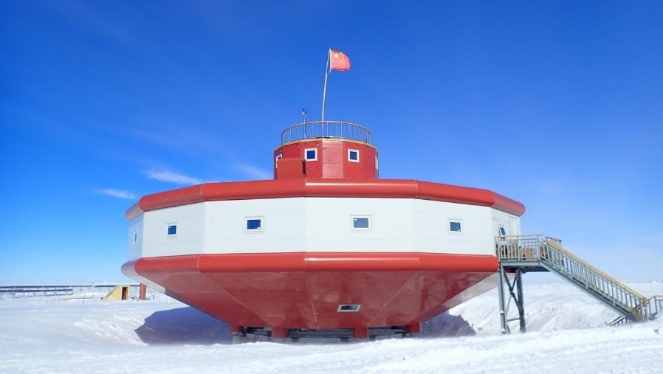
Australian inspections 2020
Taishan Camp (People’s Republic of China)

Slide 21
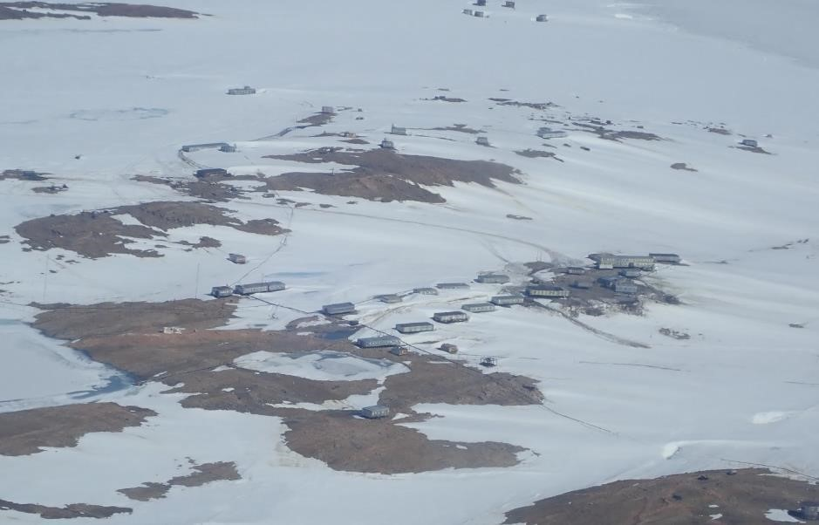
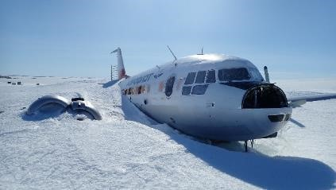
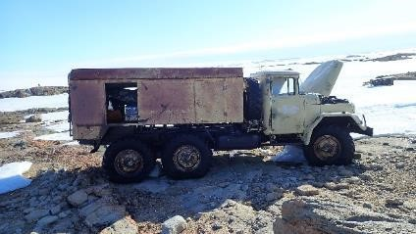
Australian inspections 2020
Molodezhnaya Station (Russian Federation)

Slide 22
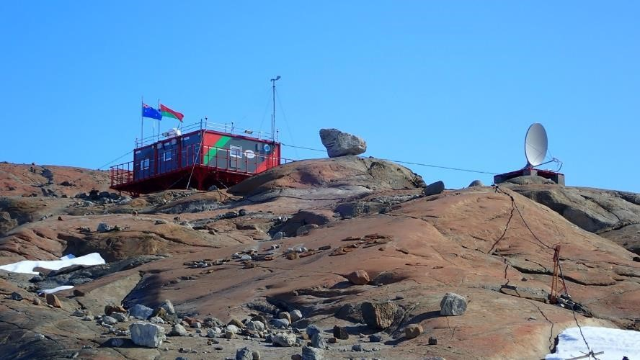
Australian inspections 2020
Mount Vechernyaya - Mountain Evening (Republic of Belarus)

Slide 23
Domestic legal implementation
Commonwealth legislation (external affairs powers)
Implementing the international requirements and applying to Australians anywhere in Antarctica
  Antarctic Treaty Act 1960
  Antarctic Treaty (Environment Protection) Act 1980
  Environmental Impact Assessment Regulations
  Waste Management Regulations
  Antarctic Marine Living Resources Conservation Act 1981
  Protection of the Sea (Prevention of Pollution From Ships) Act 1983
In addition to Commonwealth laws made for or which apply to the Australian Antarctic Territory (noting the practice of not applying laws to the nationals of other Treaty Parties)

Slide 24
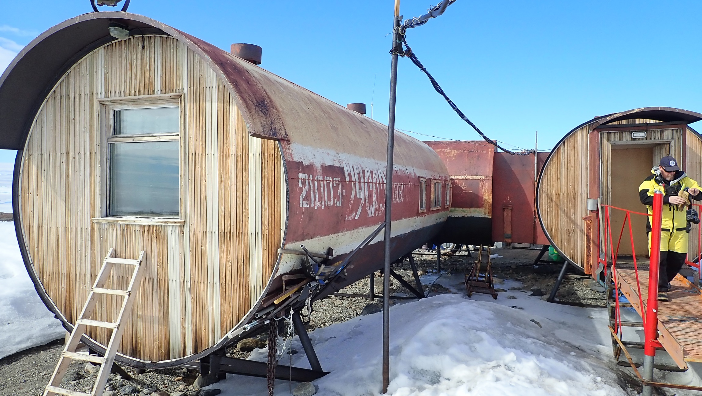
UN and global agreements
The question of Antarctica
Why not the UN?
A closed shop?
Advantages and disadvantages
UNFCCC
BBNJ
ICRW - IWC
UNCLOS and High Seas
ICAO, SAR, ISA, IMO
CBD, RAMSAR

Slide 25
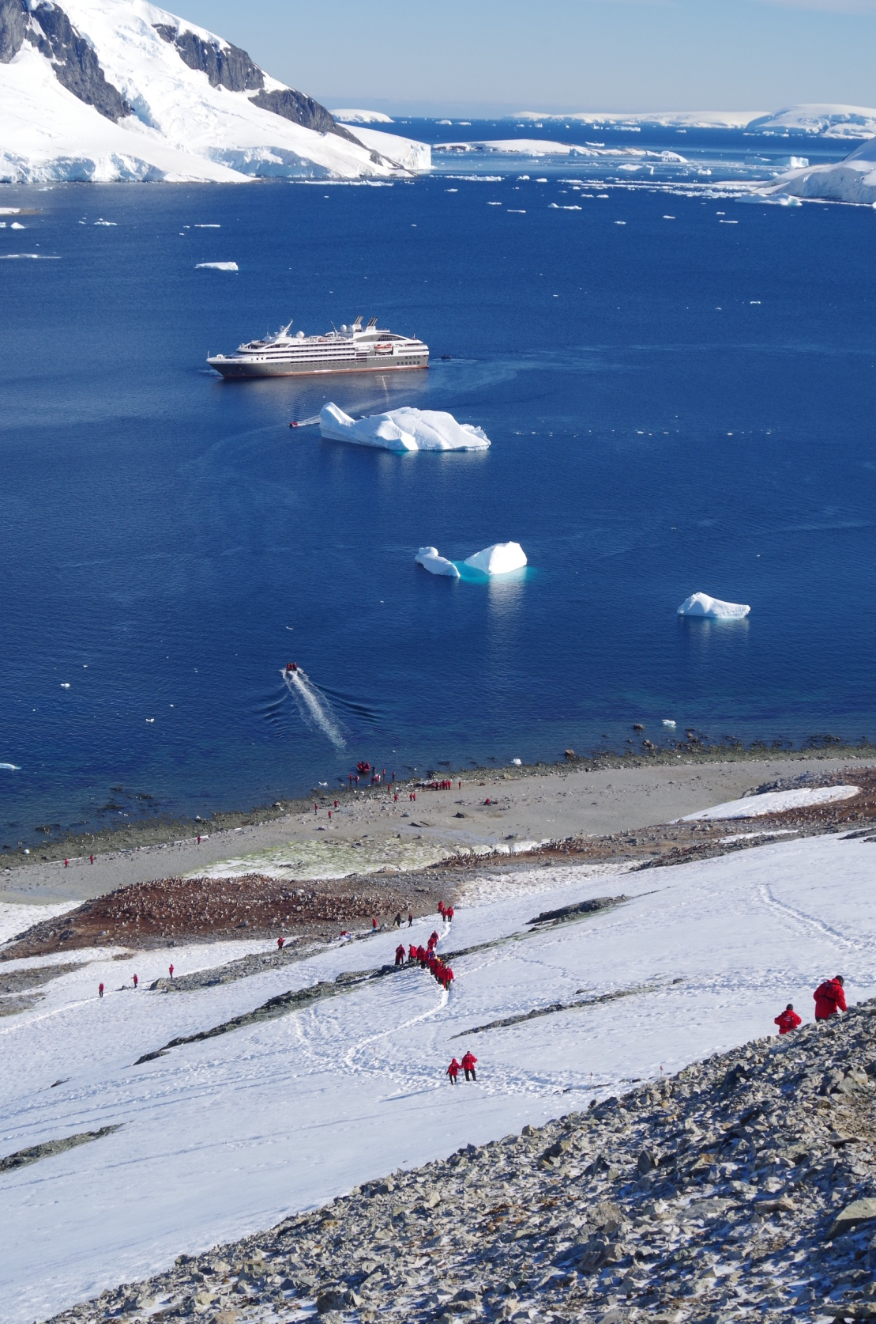
Antarctic activities and their management
Science and National Antarctic programs
Tourism
Fishing
Bioprospecting

Slide 26
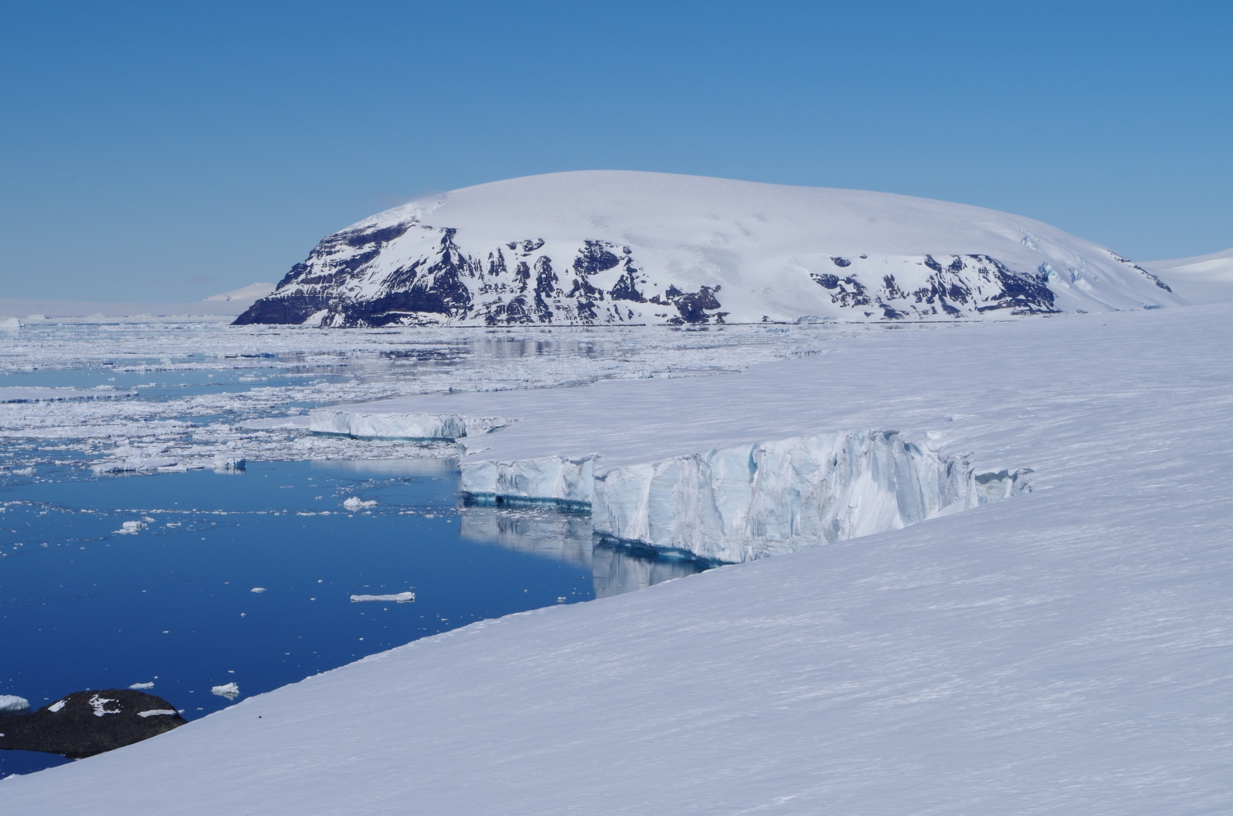
Key issues
Climate change
  Antarctic climate research
  Antarctica’s role in global climate systems, and implications for the planet
  Implications of climate change for Antarctica
Tourism management
Marine protection and management
Fishing
Liability
Bioprospecting
Competency
Maintaining consensus

Slide 27
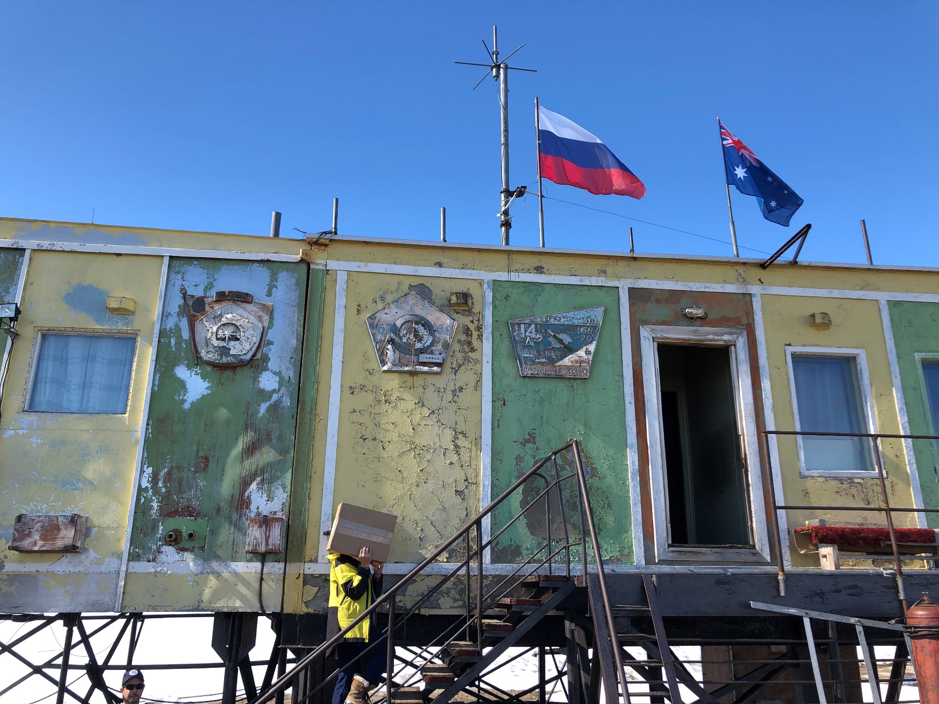
Resources
Antarctic Treaty Secretariat: www.ats.aq
CCAMLR Secretariat: ccamlr.org
Australian Antarctic Division website: antarctica.gov.au
Source texts from above Secretariats
Domestic legislation: www.legislation.gov.au
Academic treatments

Slide 28
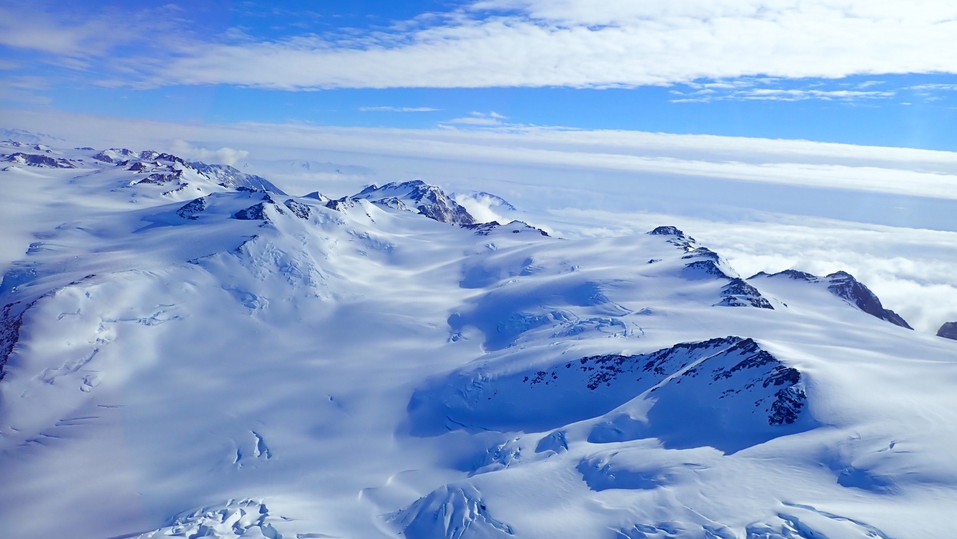
Questions?

